Slide 1
Tactile Keyboard using Micro-controller
A Mini-Project
Presentation on
Naman Kalkhuria (IEC2010065)
Prathak Rastogi (IEC2010093)
Prashant Mishra (IEC2010096)

Slide 2
Abstract
In our project, we are implementing the technique of Voltage Drop Detection.
We are going to use Arduino Leonardo Board as Micro-controller board and we are going to use Processing programming language for programming the board.

Slide 3
Motivation
Need of interaction
Most common type of interaction is touch.
To use day to day objects as keys of the keyboard.

Slide 4
Scope
For detecting the touch on a door knob.
For making the objects act as key of the keyboard.
For making keyboard just by using the pencil and paper.
For use as a hidden keyboard so as to use as a security lock.

Slide 5
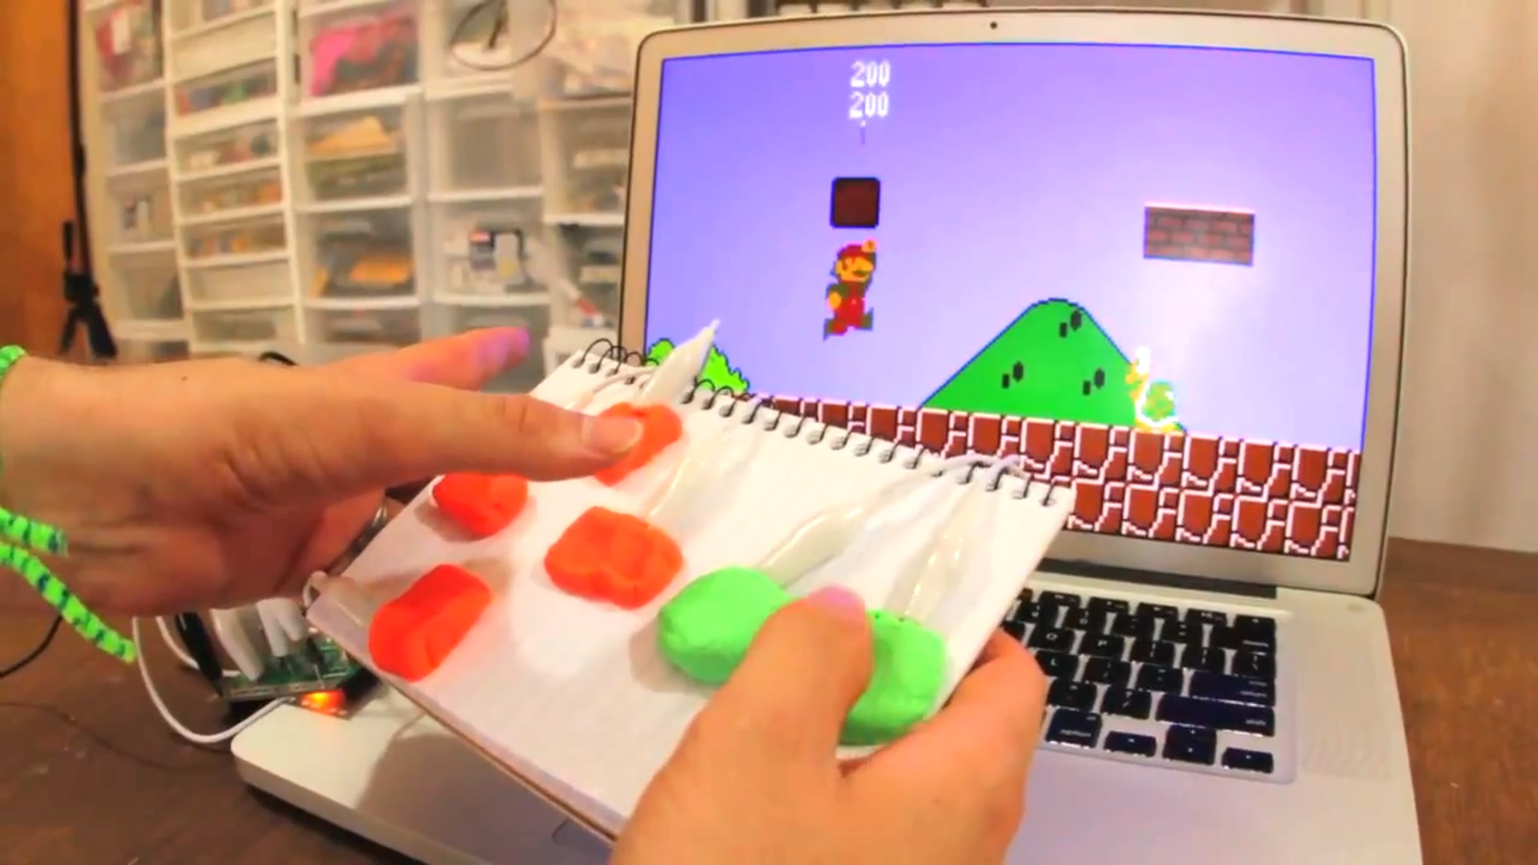
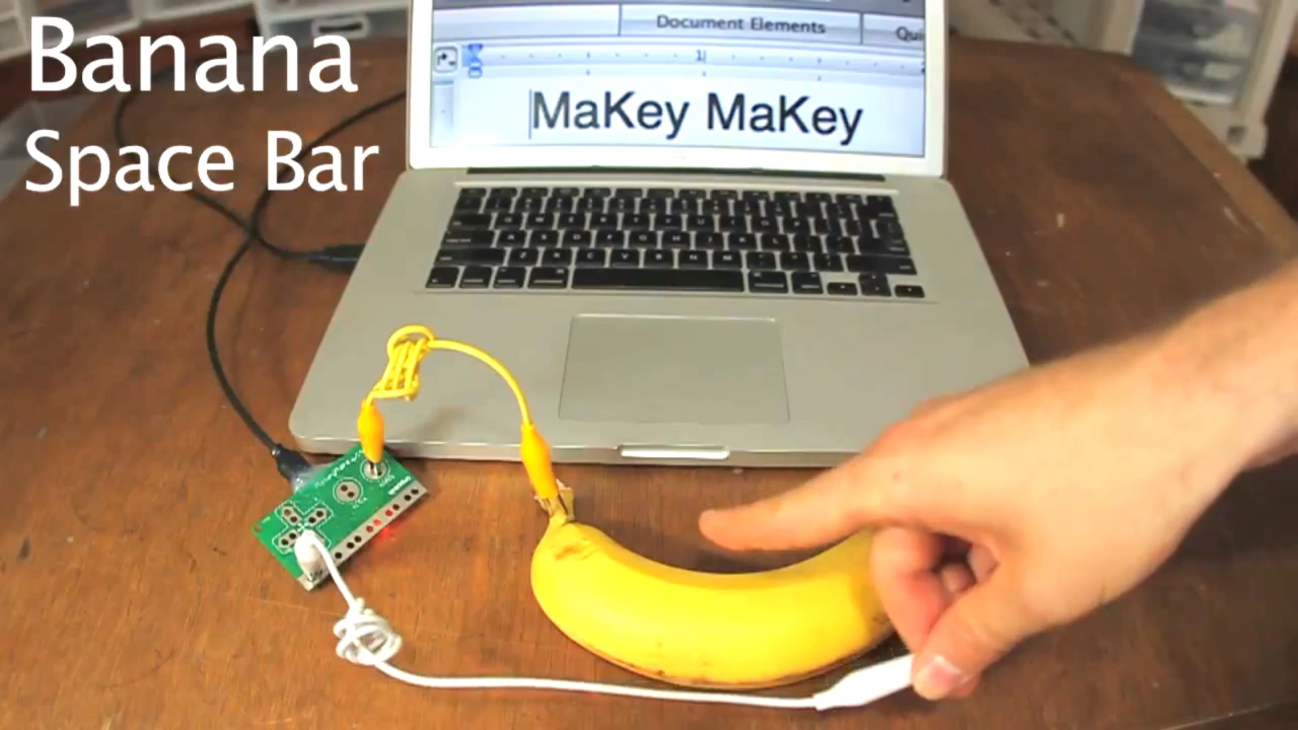
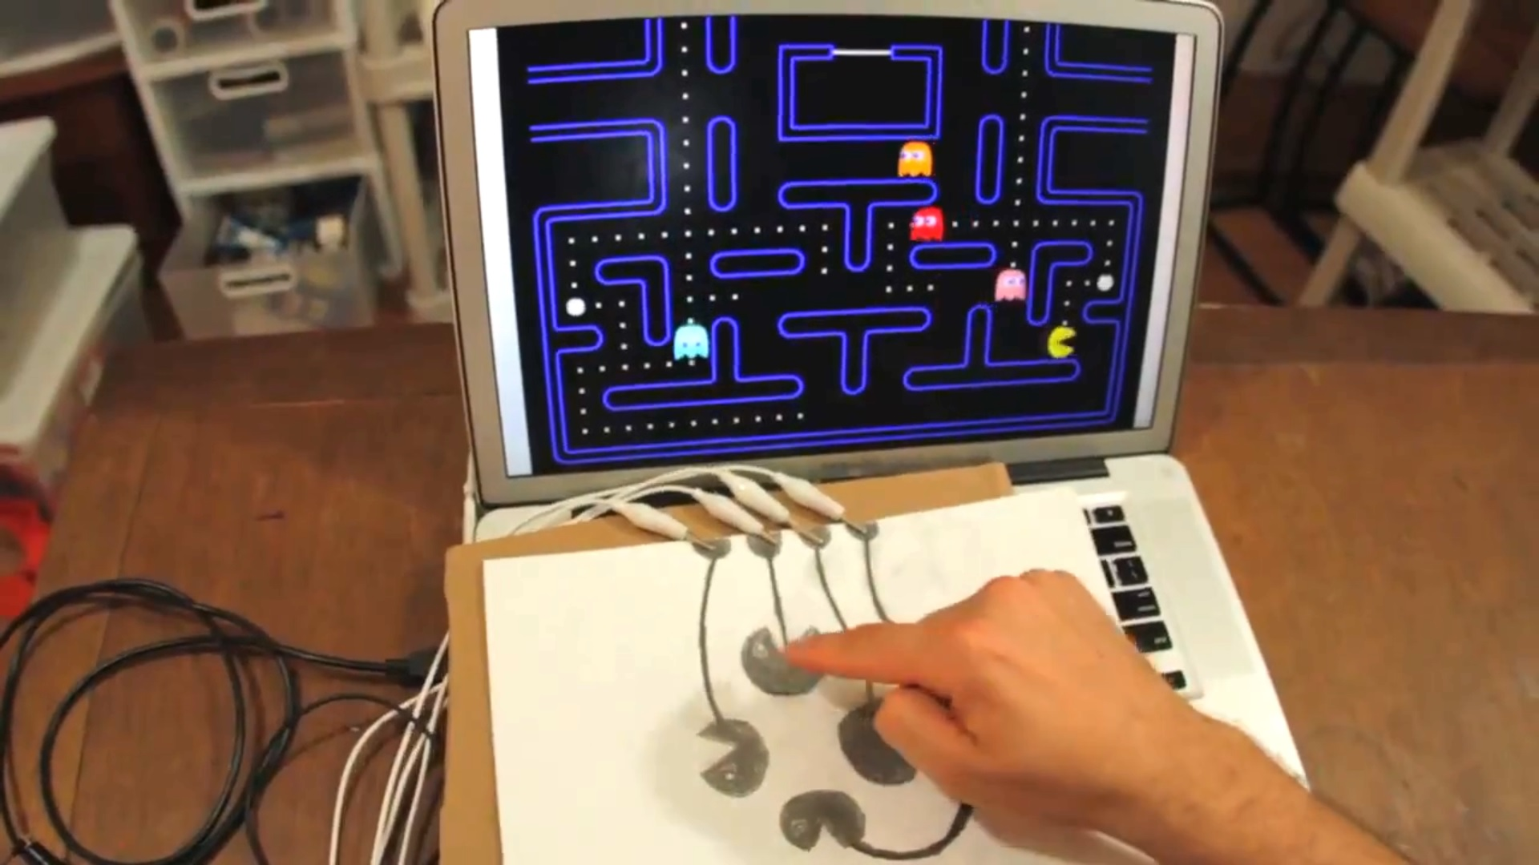
Various Applications

Slide 6
Introduction
Using Micro-controller for detecting the drop in the voltage when person touches the object.
One object act as one button and many objects can be used simultaneously.

Slide 7
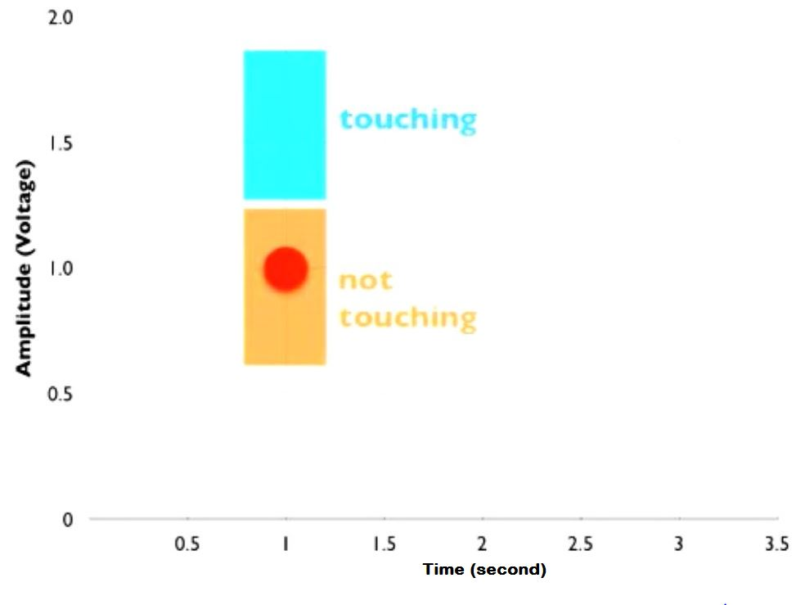
Touch of the object

Slide 8
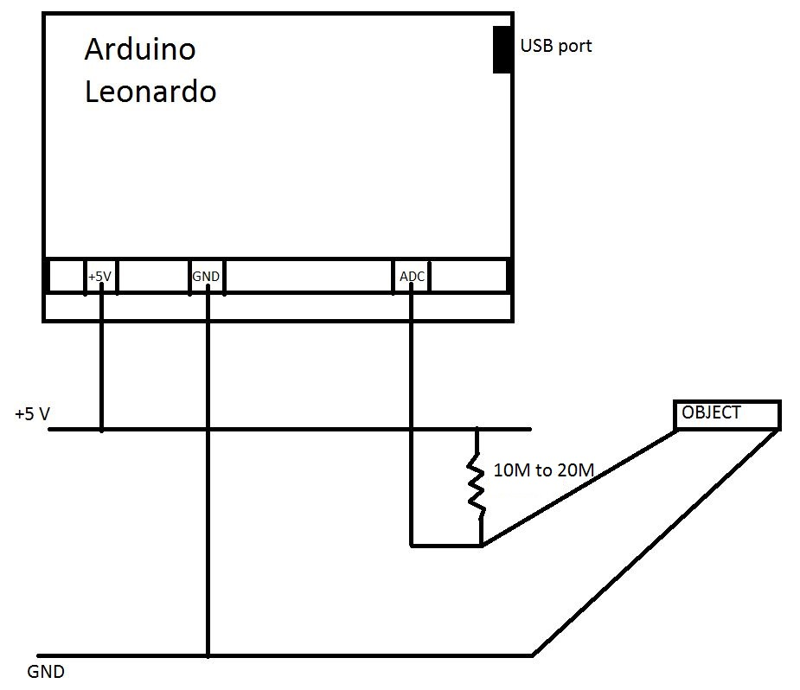
Circuit Diagram

Slide 9
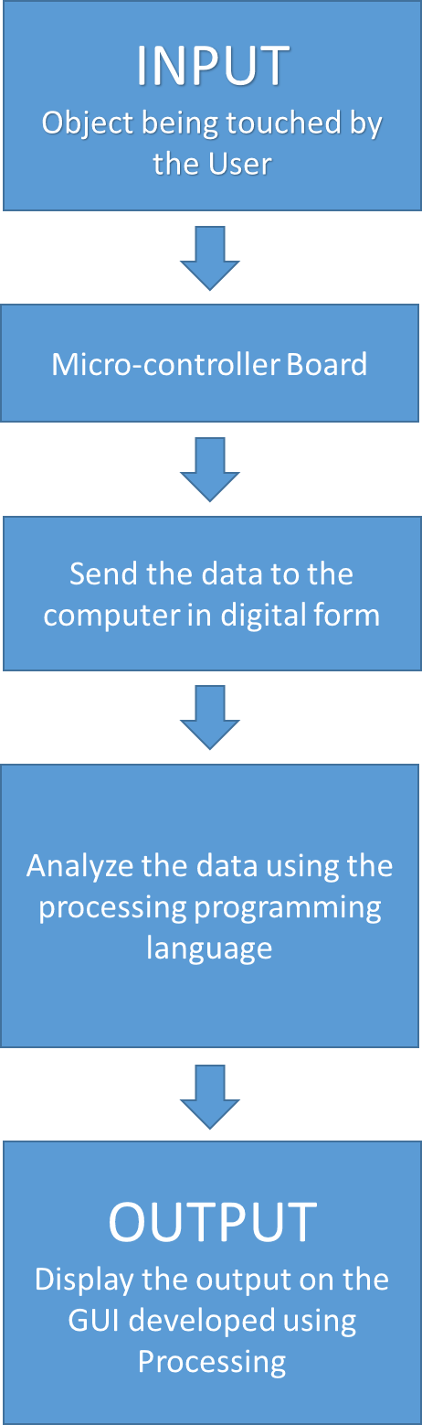
Block Diagram

Slide 10
Sensing
Voltage Drop Detection.
Here, we monitor the change in voltage when the person touches the object.

Slide 11
Various Operating Ranges:
ADC operating frequency = 200KHz
Update rate = 1Khz
Resistance value = 10MΩ to 22MΩ

Slide 12
Various buttons we are trying to program using bananas as object:
Space bar
Arrow Keys
Some alphabets like Z, X, C, V, B, N, M.
We are programming less number of keys because of limited number of ADC channels available.

Slide 13

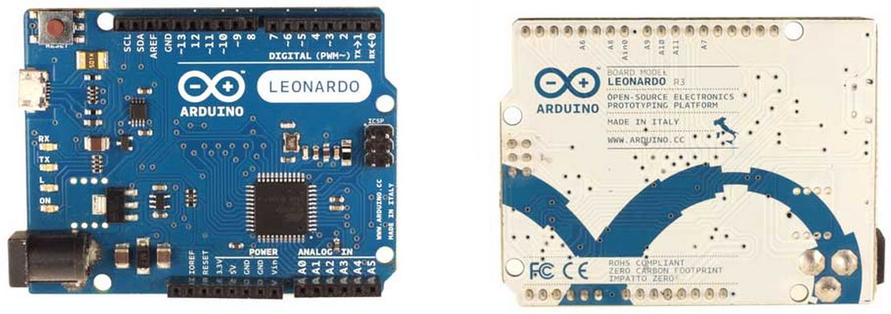
Micro-controller Board
Arduino Leonardo

Slide 14
Arduino Specs:
Microcontroller | ATmega32u4
Operating Voltage | 5V
Input Voltage (recommended) | 7-12V
Input Voltage (limits) | 6-20V
Digital I/O Pins | 20
PWM Channels | 7
Analog Input Channels | 12
DC Current per I/O Pin | 40 mA
DC Current for 3.3V Pin | 50 mA
Flash Memory | 32 KB (ATmega32u4) of which 4 KB used by bootloader
SRAM | 2.5 KB (ATmega32u4)
EEPROM | 1 KB (ATmega32u4)
Clock Speed | 16 MHz

Slide 15
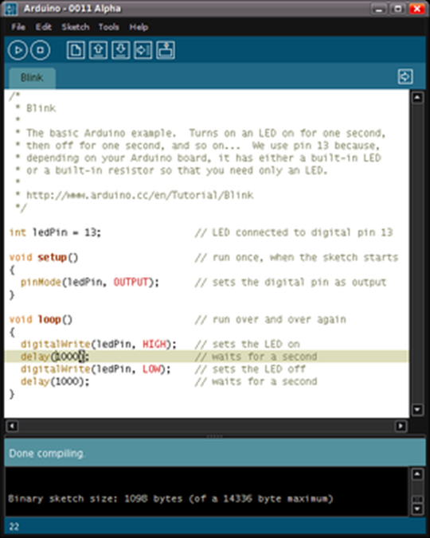
Arduino IDE

Slide 16
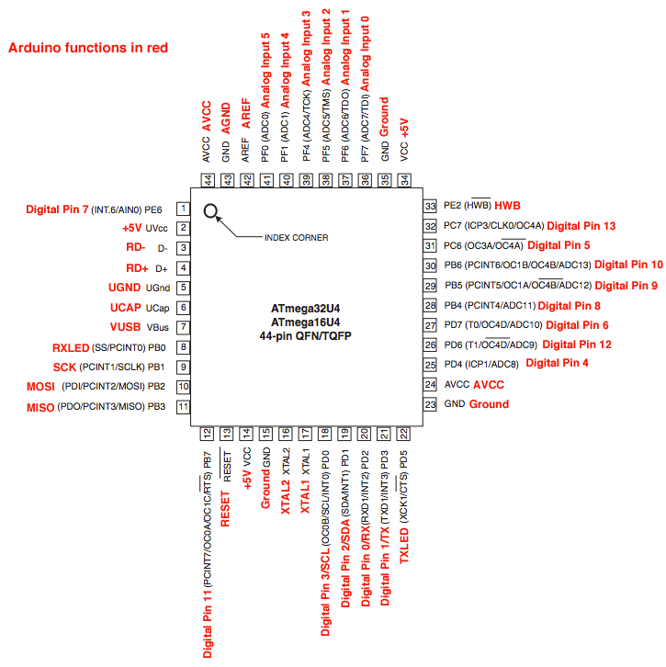
ATmega 32U4-Arduino Pin Mapping

Slide 17

Processing Programming Language
Processing is for writing software to make images, animations, and interactions.
Processing includes a sketchbook, a minimal alternative to an integrated development environment (IDE) for organizing projects.

Slide 18
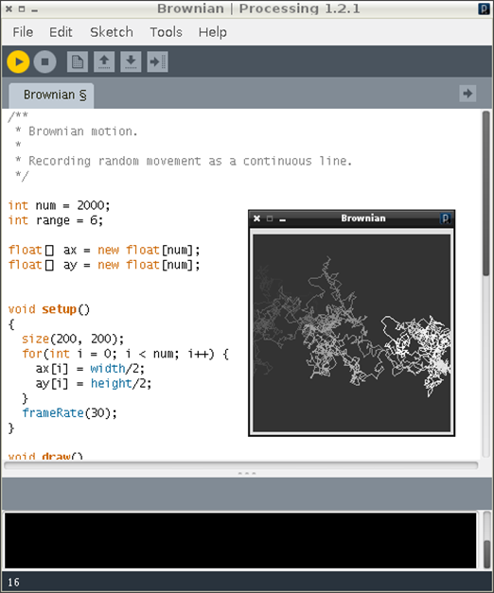
Processing IDE

Slide 19
THANK YOU

